Slide 1

Mini Project on Attendance Marking System

Slide 2

Department of Computer Engineering and Applications Institute of Engineering and technology
Team Members --
Prajesh Srivastava (181500466)
Suyash Batham (181500745)
Akash Gupta (181500058)
Supervised By
Mr.Piyush Vashishtha
Assistant Professor

Slide 3
OBJECTIVE
The main objective of this work is to make the attendance marking system fully automatic, simple and easy. In this project the facial recognition of face is done by image processing techniques. The processed image is used to match with the existing stored record and then attendance is marked and the data is stored in csv file. Compared to existing system traditional attendance marking system, this system reduces the workload of people and also saves times. This proposed system is been implemented with 4 modules such as Image Capturing, Segmentation of group photo and Face Detection, Face comparison and Recognition, Updating of Attendance in CSV file.

Slide 4
TECHNOLOGY USED
Python

Slide 5
OpenCV
OpenCV is an open-source library for the computer vision. It provides the facility to the machine to recognize the faces or objects. In OpenCV, the CV is an abbreviation form of a computer vision, which is defined as a field of study that helps computers to understand the content of the digital images such as photographs and videos. The purpose of computer vision is to understand the content of the images. It extracts the description from the pictures, which may be an object, a text description, and three-dimension model .

Slide 6
Numpy
NumPy performs array-oriented computing.
It efficiently implements the multidimensional arrays.
It performs scientific computations.
It is capable of performing Fourier Transform and reshaping the data stored in multidimensional arrays.
NumPy provides the in-built functions for linear algebra and random number generation.

Slide 7
DateTime
It is a grouping of date and time, along with the attributes year, month, day, hour, minute, second, microsecond. the datetime module work with real dates and times.

Slide 8
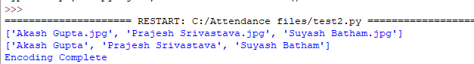
Recognized Data

Slide 9
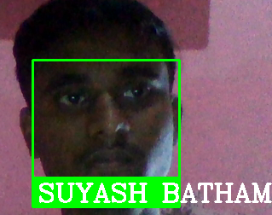
Image Recognized

Slide 10
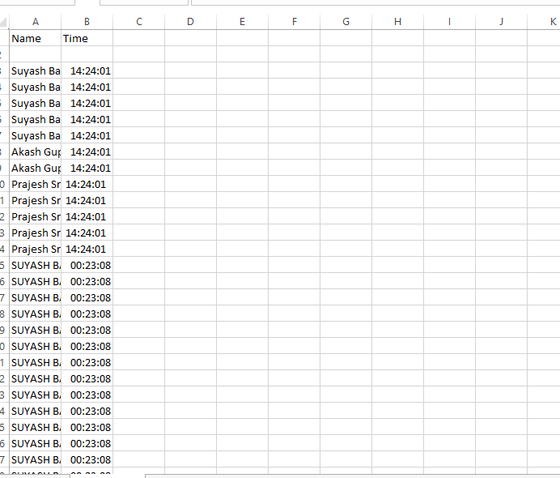
Stored Data in csv file

Slide 11
Important Link
Github Repository :
https://github.com/Prajesh-Srivastava/Attendance-Marking-System
Working Video :
https://drive.google.com/file/d/19GaU37wZjtF_a56W244dv2XtVxHqBKIl/view

Slide 12
RESOURCES
Git Hub
YouTube
Javatpoint
Stackoverflow

Slide 13
Thank you.

